Slide 1
Live Tiles and Toast Notifications Developer’s Guide to Windows 10

Slide 2
Agenda
Tile basics
Tile templates
Adaptive templates
Toast
Interactive toast

Slide 3
Tile basics

Slide 4
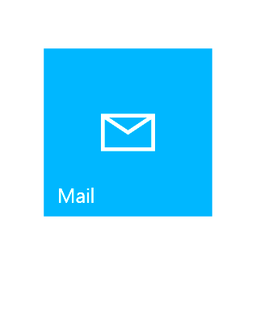
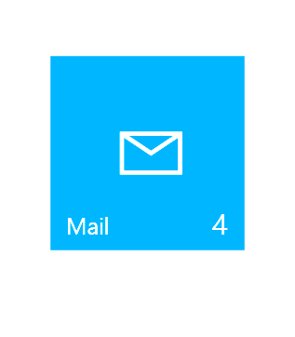
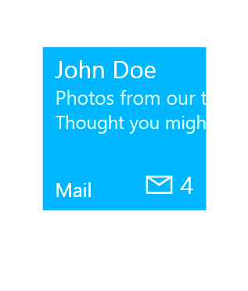
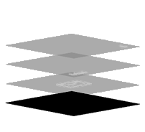
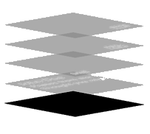
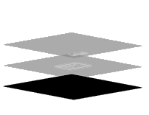
Tile anatomy
Basic State
Semi-Live State
Live State
Plate
Plate
Plate
Content
App Logo
App Logo
App Icon
Badge
Badge
Short Name
Short Name
Short Name
Badge
Badge
App Icon
Short Name
Short Name
Short Name
App Logo
App Logo
Content
Plate
Plate
Plate
Notes:
A tile is an app's representation on the Start menu. Every app has a tile. When you create a new Universal Windows Platform (UWP) app project in Microsoft Visual Studio, it includes a default tile that displays your app's name and logo. You can customize the tile so that it changes regularly to communicate new information to the user, such as news headlines, or the subject of the most recent unread message.
You can think of Tiles as being in one of three states.
In its basic state, the tile content is static and it is built up of three layers: the Plate which is the background filled with a configurable color, overlaying that you might have an image probably of the app logo, and optionally over that you can have the app short name.
A semi-live tile adds some dynamic content in the form of a badge count. Your app code can set this badge to a number or to a glyph to indicate to the user that the app has some new content.
A fully live tile incorporates more content to keep the user informed of relevant information. Live Tiles are a channel for your app to deliver content and are a great way for your app to engage with the user encourage them to open the app.

Slide 5
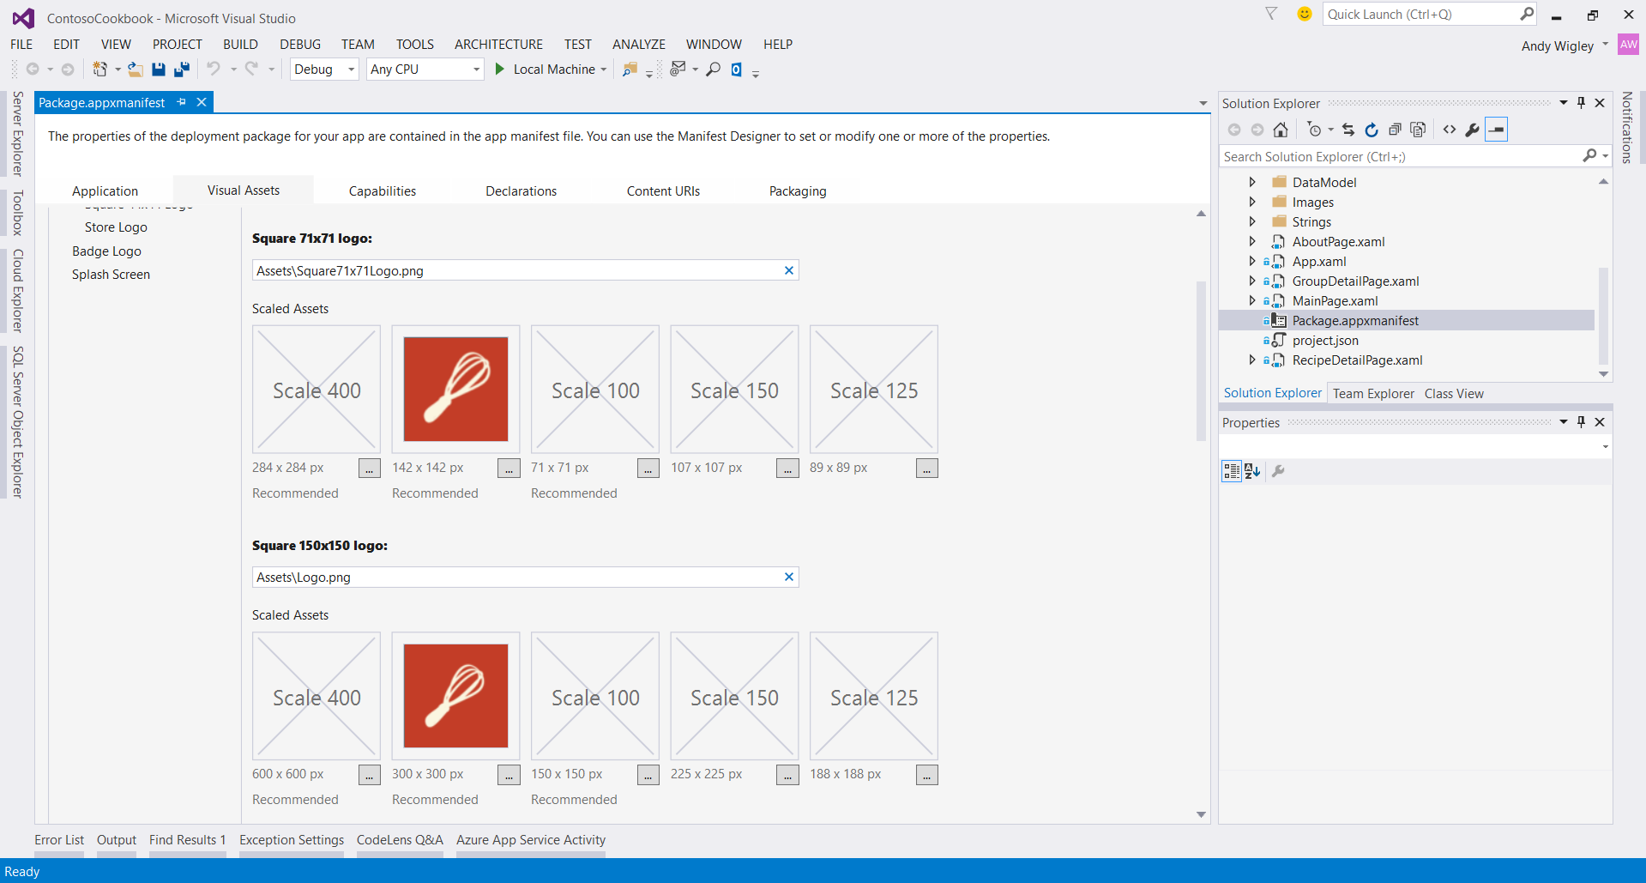
Primary Tile
Notes:
You configure the primary tile for an app using the Package manifest editor. In here, you select the images for the different sizes of tiles, can set the plate background color and set whether to display the app short name.
Notice that you can supply tile images at a number of different scales (the Scale of a device display is related to its physical screen resolution – very high resolution screens may be scale 400, low resolution screens scale 100). If you only supply tile assets at one scale, we recommend you use scale 200 as this will give acceptable results when scaled down to low resolution displays or scaled up on high resolution.
Note that the only way that the app primary tile can be pinned to the Start menu is by the user searching for the app on their machine, right-clicking it and selecting ‘Pin to Start’.

Slide 6
Updating tiles
Scheduled
Set template and time with “ScheduledTileNotification”
Periodic
Pull from URL 30m / 60m / 6h / 12h / 24h
Local
Update from (foreground/background) app
Push
Use push services
Update badge
Notes:
You can update the content of tiles in a number of different ways:
You can use the ScheduledTileNotification class to update the content by applying a tile template at a defined time.
You can define a periodic update in the package manifest, or by calling the StartPeriodicUpdate or StartPeriodicUpdateBatch APIs. You define the URL on a cloud server and the time interval and the system pulls the tile or badge content found at that URL (defined as XML) and applies it to the tile.
You can update a tile or badge directly from code in your foreground app or in a background task
You can use Push Notification services to update tile or badge content from a cloud service.

Slide 7
Update tile badge
// build badge
var type = BadgeTemplateType.BadgeNumber;
var xml = BadgeUpdateManager.GetTemplateContent(type);
// update element
var elements = xml.GetElementsByTagName("badge");
var element = elements[0] as Windows.Data.Xml.Dom.XmlElement;
element.SetAttribute("value", "47");
// perform update
var updator = BadgeUpdateManager.CreateBadgeUpdaterForApplication();
var notification = new BadgeNotification(xml);
updator.Update(notification);
Notes:
Here is an example of how to update the badge count on a tile.
<Click>
The first line gets the template for updating the badge. The second line extracts the XML for the update from the template.
<Click>
Next we drill down into the XML to locate the badge element. Then we eupdate the xml with the badge value we want to display.
<Click>
Then we call the BadgeUpdateManager to create a badge updater object, create a BadgeNotification object using the XML and then use the badge updater to apply the update.

Slide 8
Create a secondary tile
var tileId = "DetailsTile";
var pinned = SecondaryTile.Exists(tileId);
if (!pinned)
{
var tile = new SecondaryTile(tileId)
{
DisplayName = "Record details",
Arguments = "123"
};
// extra details
var success = await tile.RequestCreateAsync();
}
Notes:
Although the primary tile can only be pinned to the Start screen by the user choosing to do so, you can programmatically create secondary tiles. Secondary tiles are great for creating scenario-specific tiles and can give a shortcut into your app for the user to get direct access to a particular favorite or task. A good example is an electronic boarding pass in an airline app.
<Click>
When creating a secondary tile, the first thing to do is check if it already exists or not (i.e. it is pinned already)
<Click>
If not, you can configure a SecondaryTile object
<Click>
Then call SecondaryTile.RequestCreateAsync() which causes the Pin to Start flyout to display, through which the user can confirm that they want to create the secondary tile, which in turn creates the tile.

Slide 9
Tile templates
Notes:
A tile begins as a default tile, which is defined in your manifest and displayed when your app is first installed. After your app is installed, you can change your tile's content through notifications. When updating tiles, you work with Tile Templates which are objects that encapsulate the XML you need to update a tile.

Slide 10
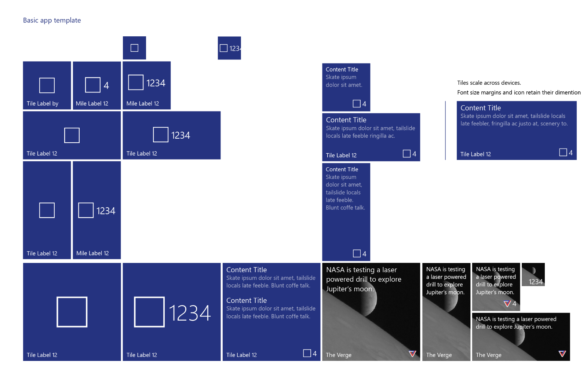
Notes:
There are many different possible sizes for a tile, and many different ways you can configure what is displayed on a tile.

Slide 11
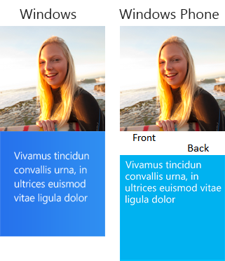
Legacy templates
If a template meets your needs, go ahead and use it.
Previous templates remain
Phone and Windows templates have been merged
There are over 80 templates available
Notes:
In Windows 8.1, you would choose a template from the system-provided template catalog that fits the layout needs of your content. For the complete list of templates, see the TileTemplateType enumeration – there are over 80 templates available.
In UWP, the desktop and phone templates from Windows 8.1 have been merged to create a consistent set of templates.
If one of the system-provided templates meets your needs, go ahead and use it. They are still supported in UWP apps.

Slide 12
Please don’t say more templates.
Notes:
However, one thing we heard loud and clear from our developers that there were too many templates and it can be confusing to find a template that meets your needs.
However, as new devices and new tile sizes become available now and in the future, how do we provide a means for developers to update these new tiles?
So in UWP, we are providing a new, more flexible way of defining tile content.

Slide 13
Adaptive templates
Notes:
This new feature is called the Adaptive Template – you can think of it as ‘one template to rule them all’

Slide 14
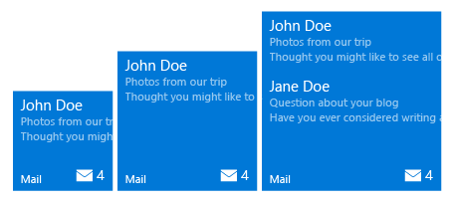
Adaptive tiles
<tile>
<visual>
<binding template="TileMedium">
<group> <subgroup>
<text hint-style="subtitle">John Doe</text>
<text hint-style="subtle">Photos from our trip</text>
<text hint-style="subtle">Thought you might…</text>
</subgroup>
</group>
<group> <subgroup>
…
</subgroup>
</group>
</binding>
</visual>
</tile>
Min. Med Size
Max Med. Size
Notes:
Adaptive tile templates are a new feature in Windows 10, allowing you to easily specify content on your tile notifications without being limited to the preset templates we previously provided in the "tile template catalog". Adaptive tile templates allow you to design your own tile notification content using a simple and flexible markup language that adapts to different densities.
<Click>
In an adaptive tile template, content for each tile size is individually specified in separate <binding> elements within the XML payload. The size you are targeting is specified by setting the template attribute to one of the following values: TileSmall, TileMedium, TileWide or TileLarge (desktop only).
A binding element can also specify a language for localisation.
<Click>
Hints are optional attributes that can be added to elements in order to achieve a specific visual behavior. Some hints might be device-specific or notification-specific, hence why they are optional.
<Click>
Adaptive templates are semantic in nature, since they are meant to work across different form factors and different types of notifications. For example, elements like group and subgroup are used to semantically link content together – they do not imply a specific visual behavior on their own. The final appearance is up to the specific device – be it a phone/desktop/Xbox, HoloLens, or smartwatch, and the type of notification – tile or toast.

Slide 15
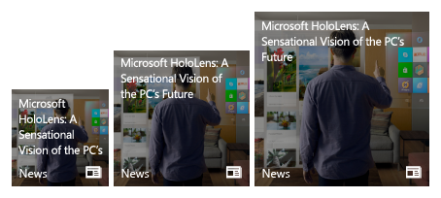
Adaptive tiles
<tile>
<visual>
<binding template="TileMedium">
<image source="Assets\image.png" placement="background" />
<text hint-wrap="true">
Microsoft HoloLens: A
Sensational Vision of the PC’s Future
</text>
</binding>
</visual>
</tile>
Min. Med Size
Max Med. Size
Notes:
<Click>
The <image> element is used to display images on the tile notification. Images can be placed inline within the tile content (default), as a background image behind your content, or as a peek image that animates in from the top of the notification.
<Click>
Use the hint-wrap attribute to set text wrapping on a text element. By default, text does not wrap and will continue off the edge of the tile. You can also control the minimum and maximum amount of lines with hint-minLines and hint-maxLines.

Slide 16
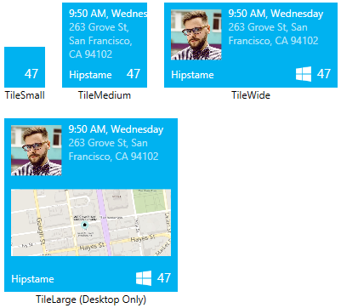
Sample: Small Tile
<binding template="TileSmall"
branding="none" hint-textStacking="center">
</binding>
Notes:
[Presenter Note: Move quickly through the next 4 slides – they should be used to illustrate how you can define bindings for different tile sizes]
You can define bindings for different tile sizes within the same adaptive template document, each displaying more content as the tile gets bigger.
First the small tile, displaying in this example little more than a badge count

Slide 17
Sample: Medium Tile
<binding template="TileMedium"
branding="Name" displayName="Hipstame">
<text hint-style="caption">
9:50 AM, Wednesday</text>
<text hint-style="captionsubtle" hint-wrap="true">
263 Grove St, San Francisco, CA 94102</text>
</binding>
Notes:
Next the Medium Tile.
This displays two pieces of text, first styled as “caption”, the second using “captionsubtle” and text wrapping

Slide 18
Sample: Wide Tile
<binding template="TileWide" displayName="Hipstame">
<group>
<subgroup hint-weight="33">
<image placement="inline" src="http://image.jpg" />
</subgroup>
<subgroup>
<text hint-style="caption">
9:50 AM, Wednesday</text>
<text hint-style="captionsubtle"
hint-wrap="true" hint-maxLines="3">
263 Grove St, San Francisco, CA 94102</text>
</subgroup>
</group>
</binding>
Notes:
By the time we get to Wide tile, we can start to incorporate an image and give a hint to layout the address text over a maximum of three lines

Slide 19
Sample: Large Tile
<binding template="TileLarge" displayName="Hipstame">
<group>
<subgroup hint-weight="33">
<image placement="inline" src="http://image.jpg" />
</subgroup>
<subgroup>
<text hint-style="caption">
9:50 AM, Wednesday</text>
<text hint-style="captionsubtle"
hint-wrap="true" hint-maxLines="3">
263 Grove St, San Francisco, CA 94102</text>
</subgroup>
</group>
<image placement="inline" src="http://map.jpg"/>
</binding>
Notes:
On desktop, you can have a large tile, and on this we can now incorporate an inline image

Slide 20
Toast
Notes:
Tiles and Toasts are closely related and use many of the same techniques for defining content and applying updates.

Slide 21
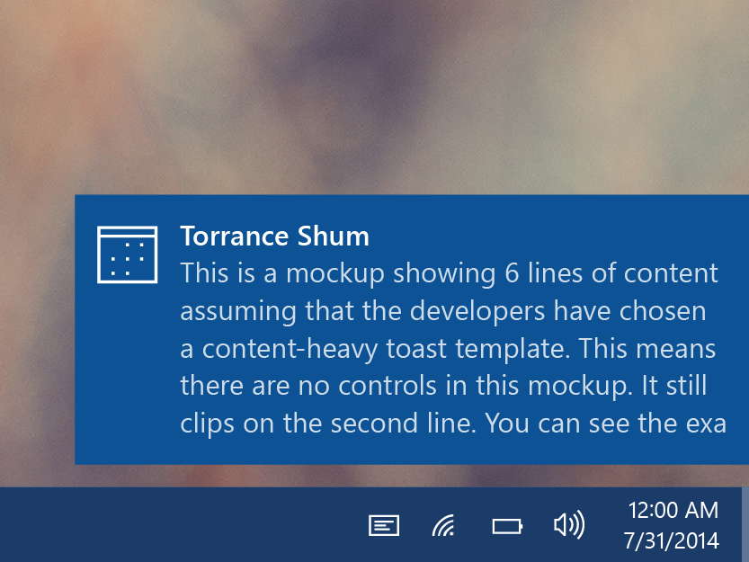
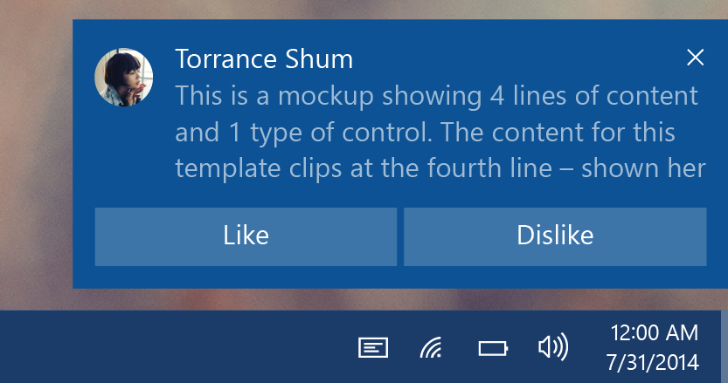
Toasts
Glance (consume)
See new information from your apps.
Act (chase, or take actions)
Toasts invite you to begin or complete a task.
The toast is the app’s door by chasing (clicking) it.
Additional actions enable users to perform simple tasks without context switching.
Notes:
Toast notifications are common on all mobile platforms. They provide an interruptive notification of some information for the user. In Windows 10, notifications slide in for a few seconds from the bottom right of a desktop of tablet screen, or appear at the top of a phone screen. They are then listed in Action Center.
In Windows 8.1 and earlier, Toasts simply conveyed information with the goal of the user glancing at it and consuming the information. You can still use toasts in this way in Windows 10.
In Windows 10, toasts get additional capabilities. They can now be interactive and offer buttons and selectable input allowing the user to perform simple tasks directly from the notification, rather than have to open the app to complete the task.

Slide 22


Toast templates
If a template meets your needs, go ahead and use it.
Previous templates remain
Phone and Windows templates have been merged
Adaptive template
Same XML syntax as tiles
Notes:
As with tile templates, Windows 8.1 templates are still available and you can use them if they meet your needs. These legacy templates do not support the new interactive toast features, though.

Slide 23
Sending toast
Scheduled
Set template and time with “ScheduledToastNotification”
Toast can also be set to be recurring.
Local
Send from (foreground/background) app
This includes desktop apps with “AppUserModelID”
Push
Use push services
Notes:
Also similar to Tiles, there are a number of methods for sending toast notifications:
You can select a template and configure the xml, then apply the update at a pre-set time using a ScheduledToastNotification
You can send toast notifications directly from your application code or from a background task
You can send toasts from a cloud service using push notifications

Slide 24
Sending toast
// build toast
var template = ToastTemplateType.ToastText01;
var xml = ToastNotificationManager.GetTemplateContent(template);
xml.DocumentElement.SetAttribute("launch", "Args");
// set value
var text = xml.CreateTextNode(content);
var elements = xml.GetElementsByTagName("text");
elements[0].AppendChild(text);
// show toast
var toast = new ToastNotification(xml);
var notifier = ToastNotificationManager.CreateToastNotifier();
notifier.Show(toast);
Notes:
Here’s an example of sending a toast using one of the legacy templates.
<Click>
This simple template, ToastText01, simply includes a single line of text
<Click>
You drill down into the XML to find the text element and append the output text as a child of that element
<Click>
Then create a ToastNotification object using the XML, and use the ToastNotifiactionManager to send the notification.

Slide 25
Interactive toast
Notes:
Glanceable information toasts are useful, but in UWP you can now have Interactive toasts.

Slide 26
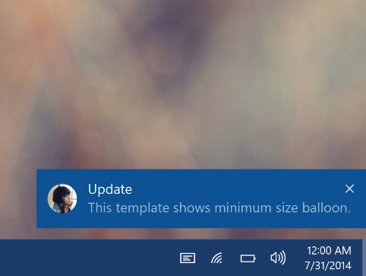
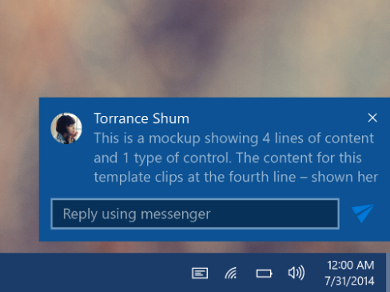
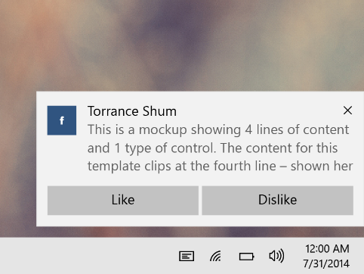
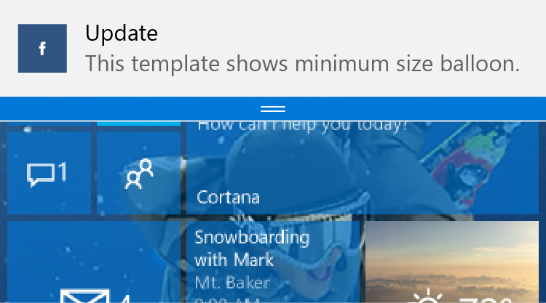
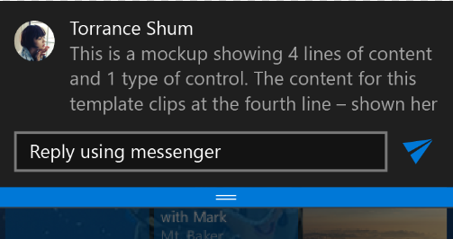
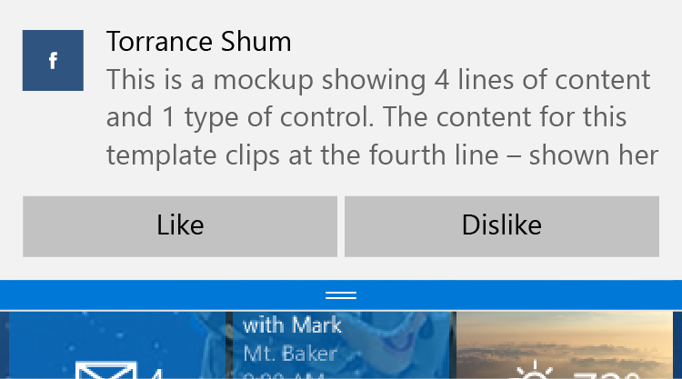
Interactive toast
Desktop
Mobile
Notes:
The left hand images here – shown for desktop above and below that how it appears on Windows 10 Mobile – are non-interactive. They inform the user of some event. The user can tap on te toast and launch the app so that they can take additional actions.
In the middle, we’ve now added an input box and a send button – the user can reply to this message directly from the toast notification, without having to launch the app.
On the right, there are two buttons. The result is the same – the user can be so much more productive because they can use the interactive toast to get things done directly!

Slide 27
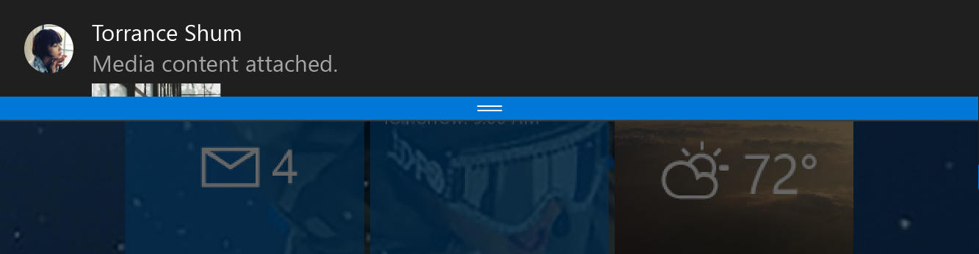
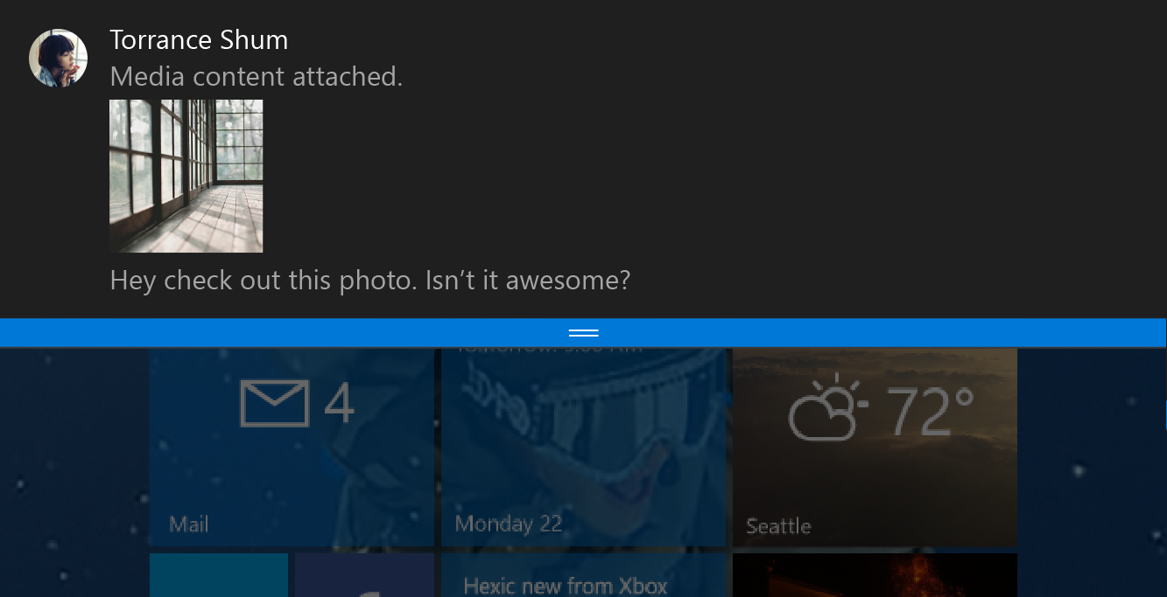
Toast notifications
<toast>
<visual>
<binding template="ToastGeneric">
<image placement="appLogoOverride"
src="Torrance Shum.png" />
<text>Torrance Shum</text>
<text>Media content attached.</text>
<image placement="inline"
src="attachment.png" />
<text>Hey check out this photo.
Isn’t it awesome?</text>
</binding>
</visual>
</toast>
Notes:
You can use the same adaptive template we used for Tiles to define toasts. This example isn’t actually an interactive toast – just an information toast –
<Click>
but this uses adaptive template xml using the ToastGeneric binding, indicating that this is defining a Toast.

Slide 28
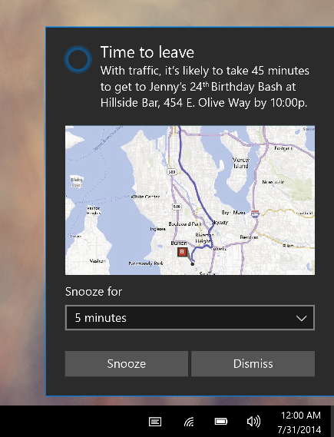
Toast input
<toast>
...
<actions>
<input title="Snooze for" id="snoozeTime"
type="selections" defaultSelection="5">
<selection id="5" content="5 minutes" />
<selection id="10" content="10 minutes" />
<selection id="20" content="20 minutes" />
</input>
...
</actions>
</toast>
Notes:
This example defines two types of interactivity:
<Click>
First there is an <input> element defining a user input
<Click>
This one is of type “selections” so it is a drop-down list
<Click>
Each selectable item is defined, with an ID and the content to display

Slide 29
Toast action
<toast>
...
<actions>
...
<action activationType="system" arguments="snooze" hint-inputId="snoozeTime" content=""/>
<action activationType="system" arguments="dismiss" content=""/>
</actions>
</toast>
Notes:
In the same example,
<Click>
the two buttons at the bottom are defined using <action> elements
<Click>
These particular <action> elements are of type “system” with the arguments specified as “snooze” and “dismiss” respectively. The system understands these as buttons that it manages, and these perform the standard snooze and dismiss actions on a reminder.

Slide 30
Toast customization
<toast>
...
<image placement="appLogoOverride" src="Logo.png" />
...
<actions>
...
<action activationType="background"
arguments="dismiss"
imageUri="send.png"
hint-inputId="1" />
</actions>
</toast>
Notes:
In Windows 10, there are many possibilities for toast notifications to be customized using adaptive templates.
<Click>
Here we use a specially prepared image to replace the standard small app logo that normally appears top left on a toast using the placement=“appLogoOverride” attribute
<Click>
What happens when a user makes a selection or clicks a button in an interactive toast? The previous example showed snooze and dismiss buttons that are system managed, but in this example, the apps background task is launched to handle the requested action
<Click>
An <action> button can also use a custom image as its content

Slide 31
New activation types & activations
<action activationType="foreground" />
<action activationType="background" />
<action activationType="protocol" />
<action activationType="system" />
Tap button
App launches
Retrieve Args
Take actions
Tap button
Task launches
Retrieve Args
Take actions
Tap button
Protocol activates
Web / app
Tap button
System handles
Notes:
The <action> buttons cause some system action to occur or some code to run, and the way you select that is with the activationType attribute.
Activationtype=“foreground” causes the app to be launched in the foreground
<Click>
ActivationType=“background” launches a background task of your app to execute code to satisfy the requested action
<Click>
ActivationType=“protocol” performs a standard protocol launch, which launches the app the user has configured in their preferred apps for handling whichever URL scheme is being used
<Click>
Finally, activationType=“system” is used, as we’ve seen for standard system functions such as Reminder snooze or dismiss

Slide 32
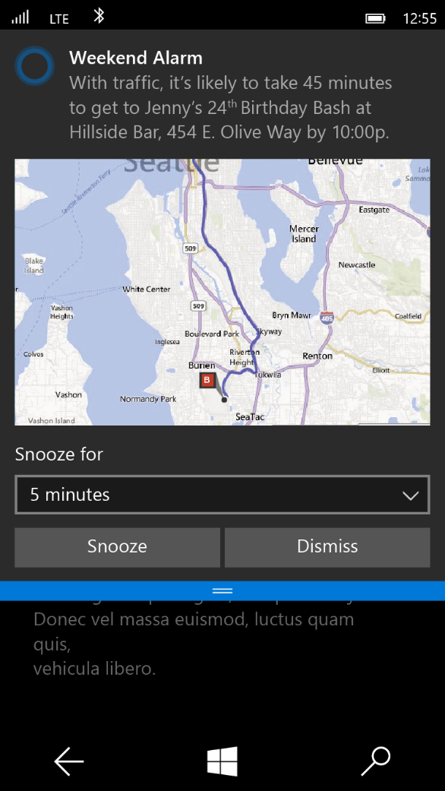
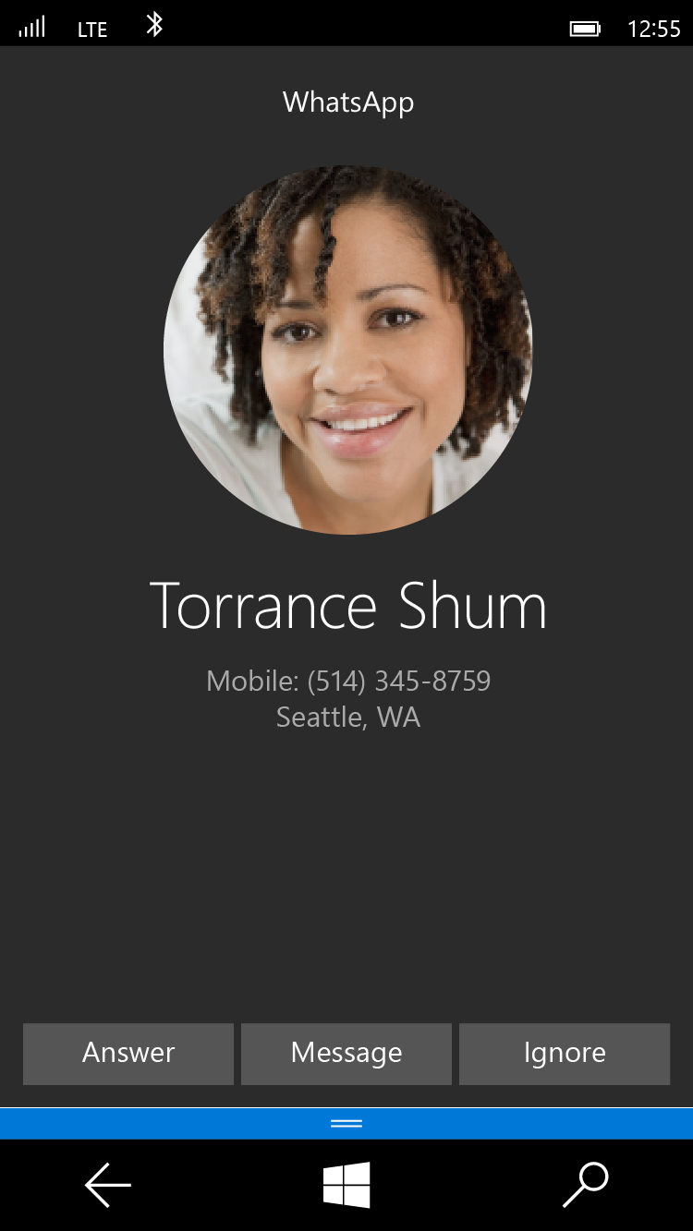
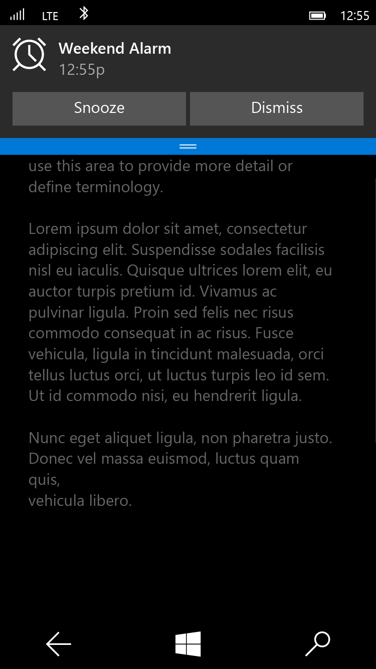
Special Toast Scenarios
Alarm
<toast scenario="alarm"...>
Reminder
<toast scenario="reminder"...>
Incoming Call
<toast scenario="incomingCall"...>
Notes:
Certain special toast types are associated with common system functions
<Click>
You set an Alarm using <toast scenario=“alarm”…
<Click>
Similarly for a Reminder
<Click>
And if you are creating a VOIP app, you can show an incoming call alert using <toast scenario=“incomingCall”…

Slide 33
Demo: Interactive Toast

Slide 34
Review
Tile basics
Tile templates
Adaptive templates
Toast
Interactive toast

